Slide 1
Intro to Data Science
Karan Shukla

Slide 2
Downloads
karan.shukla@utdallas.edu
RStudio
https://www.rstudio.com/
Slides, Data, and Code
https://github.com/shuklak13/Intro2DataScience

Slide 3

ACM
Slack
ecsutd.slack.com
Next Week
Intro to Machine Learning, 3/29 8:30pm at ECSS2.415

Slide 4

About Me
B.S. in Computer Science, 2017
M.S. in Computer Science, 2018
internships at Verizon, IBM in data science, software engineering
call volume prediction
market segmentation
anomaly detection
joining Google after graduation

Slide 5
What is data science?
“Data science… is an interdisciplinary field about scientific methods, processes, and systems to extract knowledge or insights from data in various forms” - Wikipedia

Slide 6
What is data science?
Scientific Method
Hypothesize → Experiment → Share Results → Repeat
Applied Statistics…
… using research techniques
… with the help of technology
Notes:
Hypothesis – Bayesian Prior Beliefs

Slide 7













Who needs data scientists?
Notes:
Basically any company that handles a lot of data

Slide 8
What do Data Scientists create?
Reports / Visualization
Predictive models / Machine Learning
Automated decision making / Artificial Intelligence

Slide 9
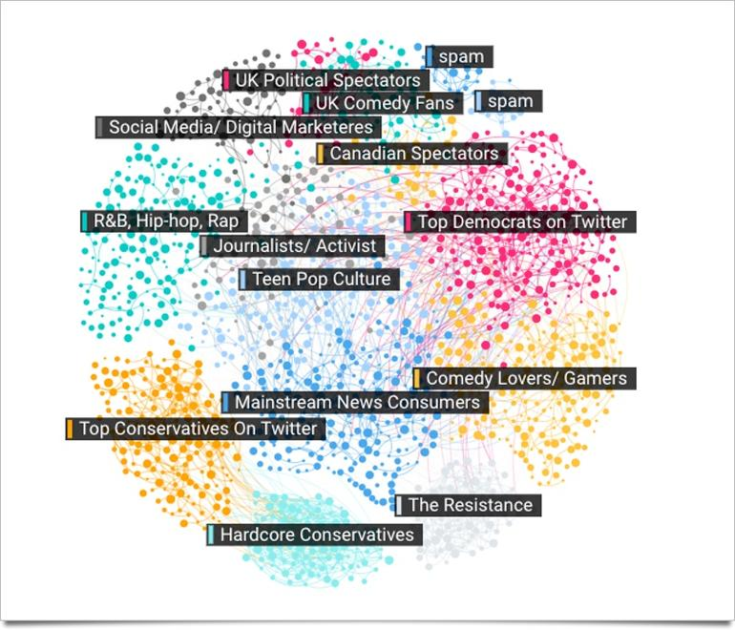
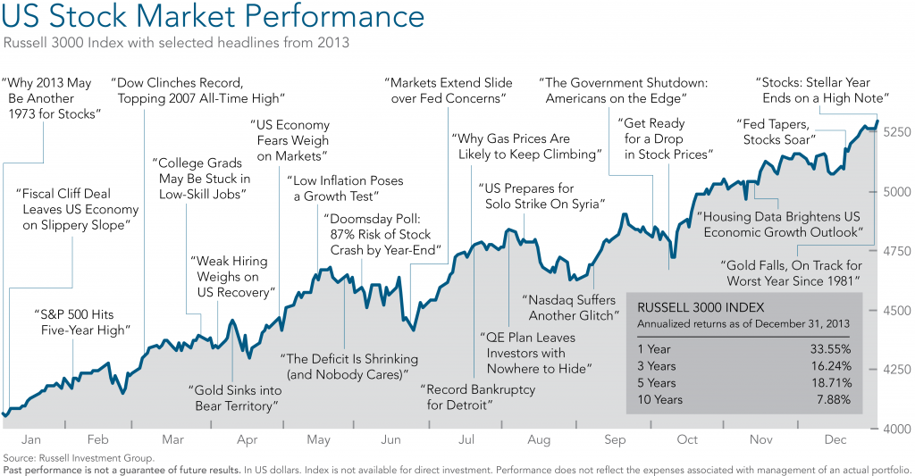
Reporting
Notes:
Maps, Time Series, Clustering

Slide 10
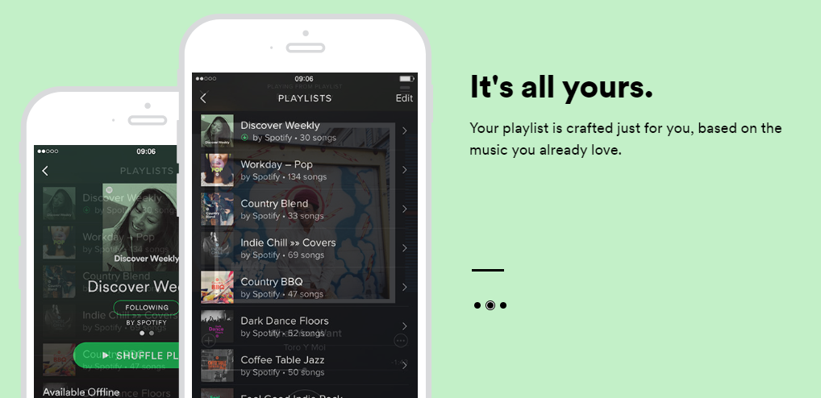
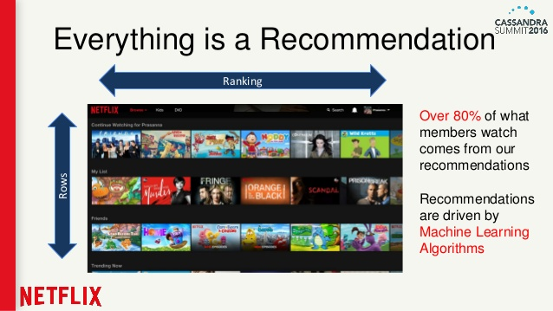
Predictive Models

Slide 11
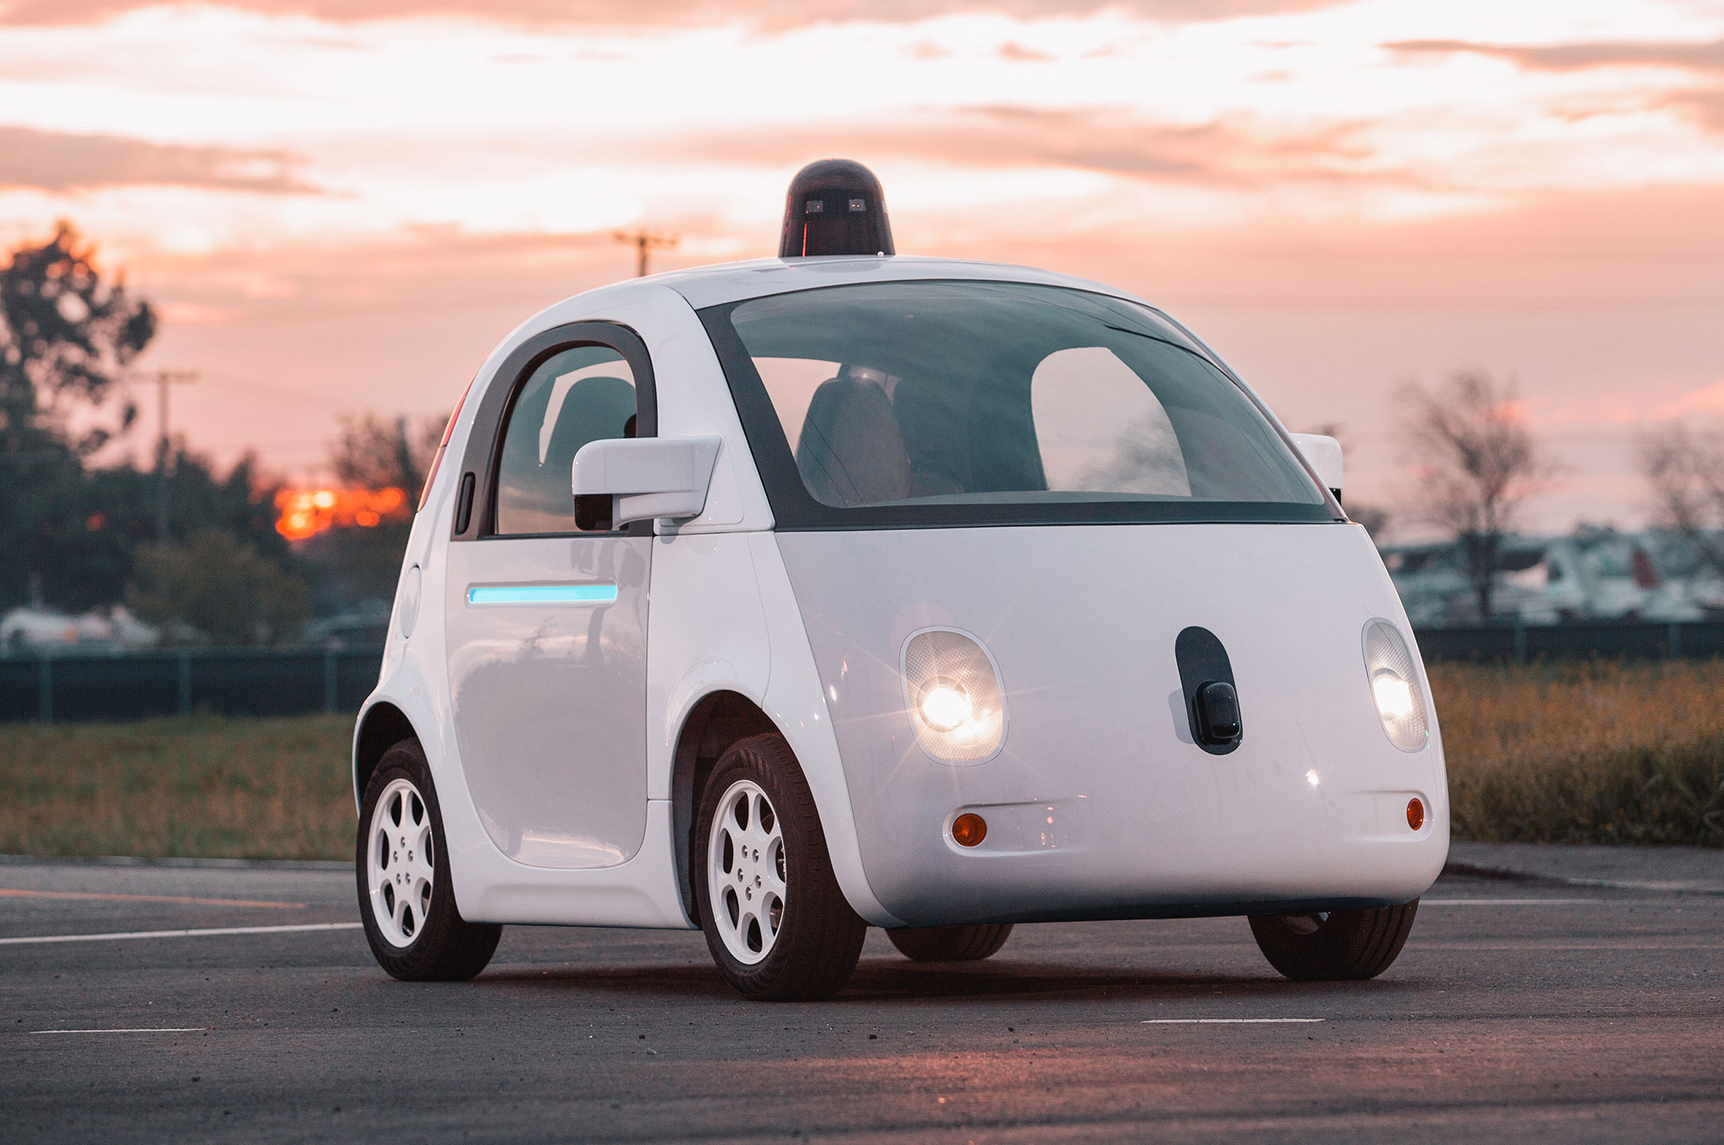
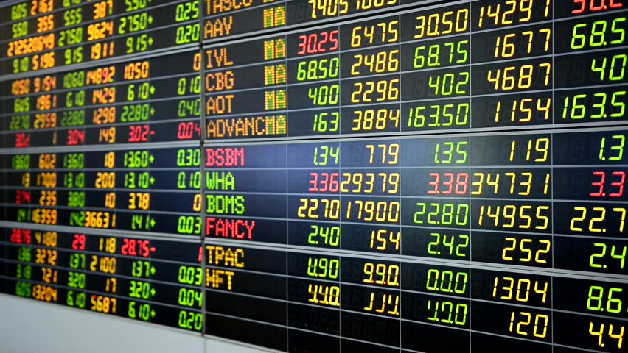
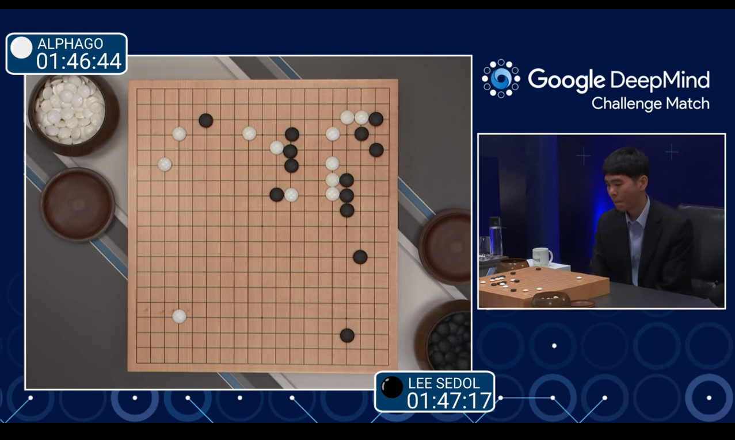
Automated Decision Making

Slide 12

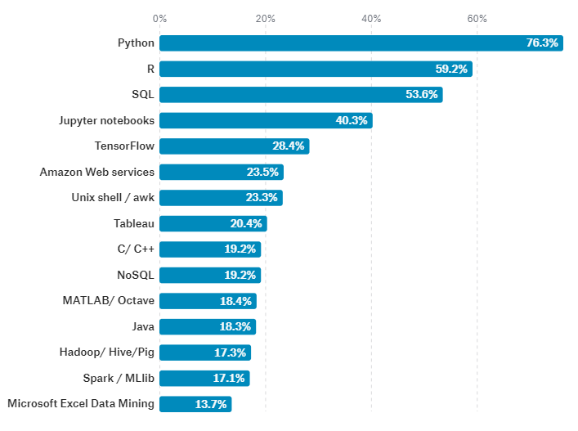
What tools do Data Scientists use?
[from Kaggle’s 2017 Survey on Data Science]
Notes:
Python – Swiss Army Knight; R – popular w/ statisticians
Jupyter – sharing interactive documents; like an online IDE

Slide 13
What math do Data Scientists use?
Statistics
Hypothesis Testing, Significance, Correlation
Calculus and Optimization
Maxima and Minima, Gradient Descent
Linear Algebra
Principle Components Analysis
Machine Learning (applied Stat/Calc/LinAlg)
Regression, Classification, Clustering
Notes:
Statistics – extract information from a population using a sample Calculus – foundation of machine learning theory LinAlg – reducing high dimensional spaces

Slide 14
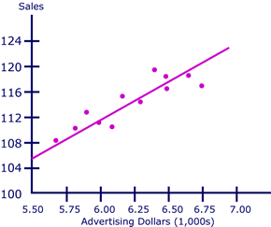
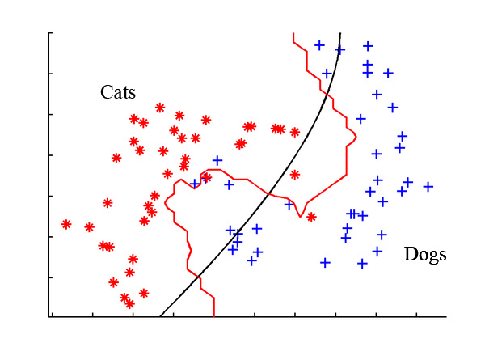
Terminology
Statistics Observations are in Samples and have Variables
Data Science Observations are in Datasets and Features
Regression – identifying correlations between features
Predictive Models, A/B Testing
Classification – classifying observations based on their features
Customer Segmentation, Facial Recognition
Training and Testing – evaluating your model with a different dataset
Overfitting – creating a machine learning model that learns the training data “too well”
fix via Feature Engineering or Regularization
Notes:
DS terms are more programmery Almost all predictive models use regression techniques (some vars you know, some you don’t)
A/B Testing – Facebook shows users two versions of their site – A and B – measure user behavior Feature Engineering – “big data” reduction (via rmving, combining) Regularization – weaken the model’s power

Slide 15
How is Data Science different from Big Data?
“The key word in ‘Data Science’ is not Data, it is Science” – Jeff Leak
Data Science applied statistics
What is it? Answering questions and making decisions using math and data
Big Data Data Engineering engineering at scale
What is it? Designing scalable computer systems to handle massive storage + computation
Classes: Operating Systems, Databases, Distributed Computing, Big Data
Classes: Statistics, Calculus, Machine Learning, Artificial Intelligence
Notes:
Might be confusing b/c both have “data” – but one is science and one is engineering “scalable” = buzzword (users, data, machines)

Slide 16
Resources for Data Science
Coursera
Data Science Specialization (Roger Peng)
Machine Learning (Andrew Ng)
Books
“Discovering Statistics using R” by Andy Field
“Data Science from Scratch” by Joel Grus
“An Introduction to Statistical Learning” by Trevor Hastie
“The Drunkard’s Walk” by Leonard Mlodinow
Blogs
Erik Bernhardsson – ex-Data Scientist at Spotify
Medium: Netflix Blog and Twitch Blog
Datasets
Kaggle
Notes:
The Drunkard’s Walk – pop sci book; real-world examples of logical fallacies and applications of statistics; gr8 if you want to learn how to think like a Statistician / Data Scientist; history of stats (gambling addictions / jerks)

Slide 17
Downloads
RStudio
https://www.rstudio.com/
Slides, Data, and Code
https://github.com/shuklak13/Intro2DataScience

Slide 18
Questions?
Feedback Poll: goo.gl/DVmkCg

